Slide 1
Minesweeper
By Shane Abrahams

Slide 2
Minesweeper flow-chart
As you start a new game a grid of gray squares will appear.
Left-click on any gray square. If there is a mine hidden under the square, you lose the game. If there isn't a mine under the square, there will be a number – one through eight –indicating how many mines are under the eight neighboring squares.
To determine safe squares, by using the uncovered numbers. Lower numbers indicate fewer mines close to that square. If the number is a "1," then there is only one mine around that square, and seven safe squares.
Flag squares that you deduce are hiding mines by right-clicking on them.
Locate all the mines and uncover all the number squares to win the game and become the ultimate minesweeper.
If you by chance clicked on a mine, try again by starting a new game until you have located all the mines without left-clicking on them.
STEP 1
STEP 2
STEP 3
TIP
Start on the easiest setting and work your way up to harder settings.
TIP
Start on the easiest setting, and work your way up to harder settings.
STEP 6
STEP 5
STEP 4

Slide 3
Rules
The object of the game is to uncover the map without clicking on any mines. Open a new game then left click randomly until you uncover some space and information to work with. If you click on a mine, you lose the game. Click on the smiley face to start a new game. A numbered square indicates how many mines are adjacent to that square either above, below, right, left or diagonally. Spaces not adjacent to any mines are blank, showing no number. The lowest number is 1 and the highest is 8. Using reason and deduction, use the known information from the revealed numbers to figure out where the mines are located. Right click to flag a spot you know where a mine is. Right click on a flagged to clear the mark. You will be unable to accidentally left click a marked square. If you perform a right and left click simultaneously on a number that has the corresponding number of flags adjacent to it, it will open all the squares surrounding that number that don’t have flags. You can also left click on the number to accomplish this. Once all the mines have been properly marked and the rest of the board cleared, you win.

Slide 4

Step 1 – Starting a new Game
Start a new game.
A grid of gray squares will appear.

Slide 5
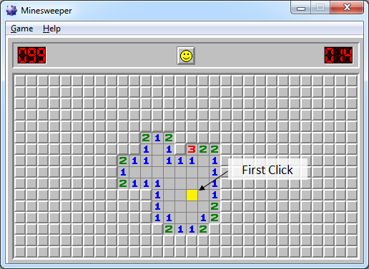
Step 2 – Click on a square
Left-click on any gray square. On a Mac, simply click on it.
If there is a mine hidden under the square, you immediately lose the game.
If there isn't a mine under the square, there will be a number – one through eight –indicating how many mines are under the eight adjacent squares.

Slide 6
Step 3- Locate other safe squares
Determine safe squares by using the uncovered numbers.
Lower numbers indicate fewer mines adjacent to that square. If the number is a "1," then there is only one mine around that square, and seven safe squares.

Slide 7
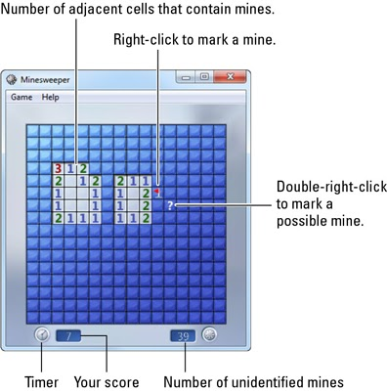
Step 4 - Flag possible mines
Flag squares that you deduce are hiding mines by right-clicking on them.
On a Mac, hit the option key at the same time you click the mouse.

Slide 8
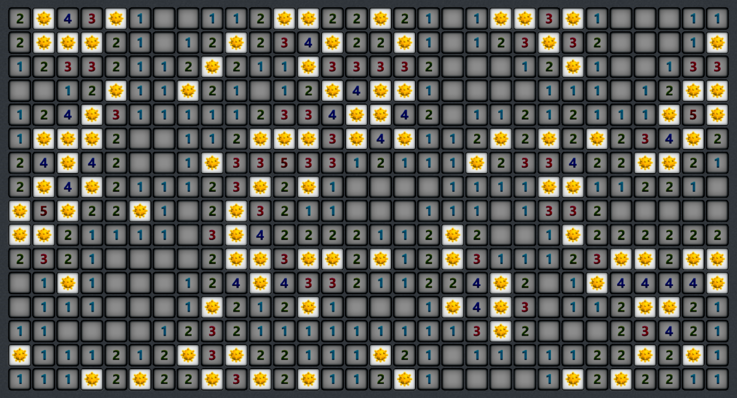
Step 5- Locate all the mines
Locate all the mines and uncover all the number squares to win the game and become the ultimate minesweeper.

